Slide 1
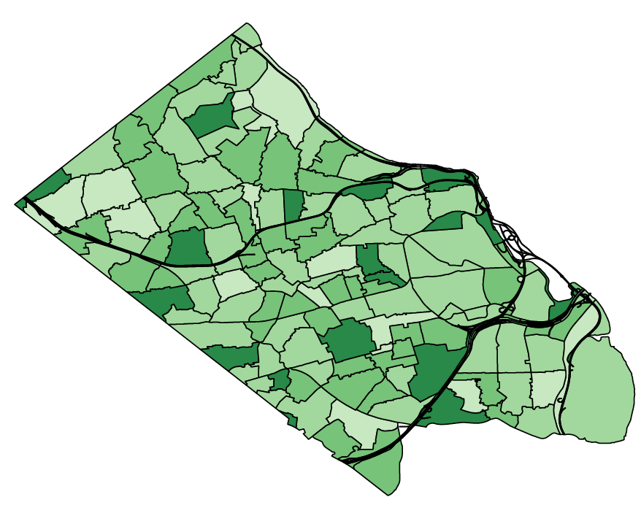
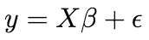
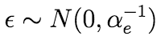
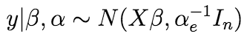
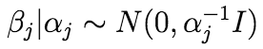
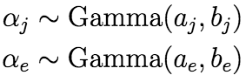
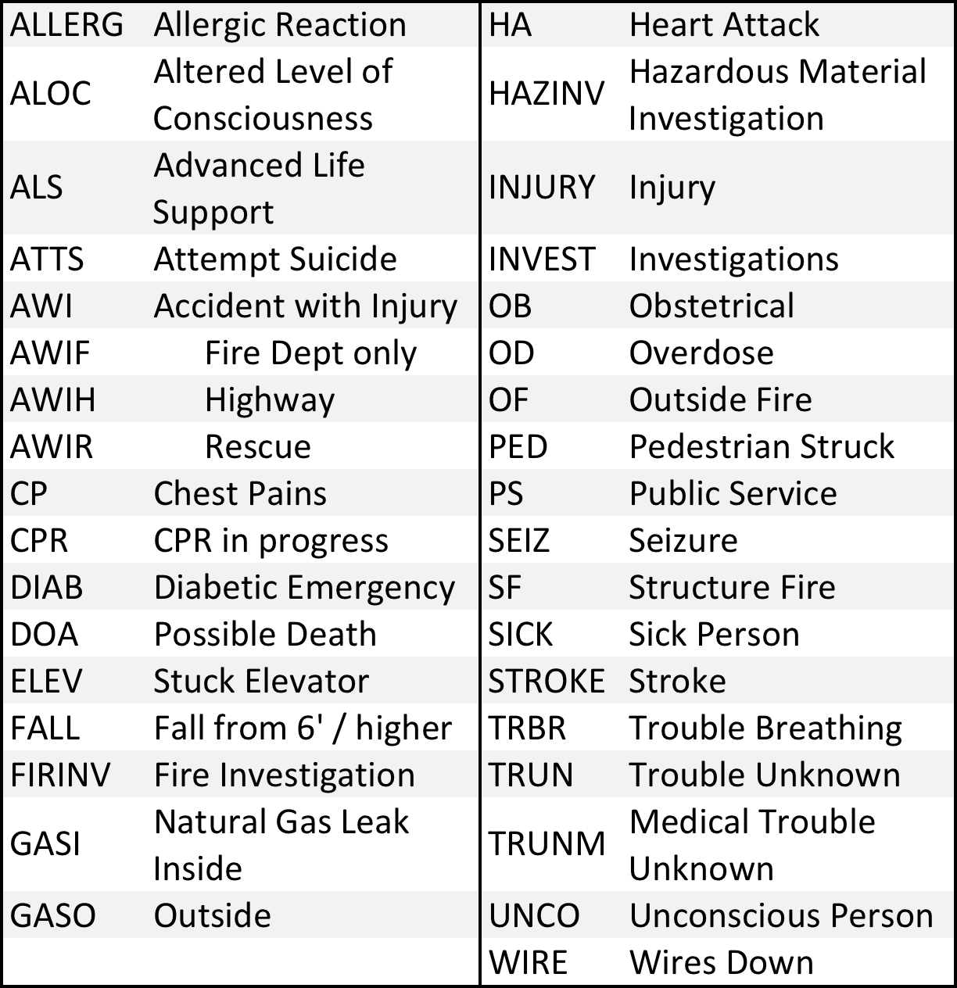
911 RESPONSE TIMES
Data Science for the Public Good
Madison Arnsbarger (Virginia Tech), Jessica Flynn (Cornell University), Sam Tyner (Iowa State)
with Gizem Korkmaz, Joshua Goldstein, and Vicki Lancaster (SDAL)
Research Question
In order to improve the general safety of Arlington County residents, to make the allocation of emergency resources more efficient, and to improve situational awareness, it is important to reduce the response time to incidents. This project aims to identify and understand the factors affecting response time to incidents.
Data
CAD Call Type Descriptive Analysis
Arlington County Fire and Emergency Data
Raw data has 870,906 observations
86 different variables including the location and the time of the incident, CAD (computer-aided dispatch) call types, fire stations, responding units
In the dataset, there are
184 CAD call types
10 fire stations
30 apparatus types
Years 2010-2015
Response Time = Arrival Time – Dispatch Time
Here, we focus on the most frequent 9 CAD call types: ALOC (altered level of consciousness), ALS (advanced life support), AWI (accident with injury), CP (chest pains), INJURY (injury), PS (public service), SF (structure fire), SICK (sick person), and TRBR (trouble breathing)
Frequency of calls at 3:00 pm by Firebox
Frequency of CAD Calls by Hour
Fire Station Descriptive Analysis
Year
Response Time by Station
Frequency
Response Time (min)
The trellis plot on the right displays the frequency of the 9 CAD call types by hour of the day. For most types, the frequency peaks around 3:00 pm and then decreases. The exception is structure fires (SF) which displays an increasing trend starting around 5:00 pm.
Distance (mi)
Bayesian Hierarchical Model
Hour
When a 911 call comes in, the fire station nearest to the incident is dispatched; this is displayed in the above map. Each point represents an incident and the color the district of the responding fire station. In some cases, the units in the station nearest to the incident are unavailable, this is displayed in the above trellis plot. The plot displays the incident response time by distance for the 10 fire stations. Distance is calculated “as the crow flies,” from the responding station location to the incident location. The color represents the district closest to the incident. For example, in the plot for station 109, the pink points represent incidents within district 105 responded to by station 109. This may explain why response time is longer for these incidents.
We use a Bayesian linear model for response time to analyze the effect of various predictors (X), including hour of the day, CAD call type, station, year, month, and apparatus type, on response time (y) to an incident ~1 mile away. The model excludes ALARM CAD call types and response times longer than 20 minutes (less than 1% of the data). Inference is done by Markov Chain Monte Carlo using a Gibbs sampling method.
Likelihood
Priors
Findings
(a)
(b)
CAD Call Types
(c)
Response Time (min)
Response Time (min)
Response Time (min)
Hour of the Day
CAD Call Type
Station
The results from the Bayesian analysis are displayed in the three figures above. These are the model effects of hour of day, CAD call type and station on response time to an incident that is 1 mile away. Figure (a) shows that on average, response time increases steadily from midnight to 9:00 am, followed by a sharp decrease around 10:00 am. Figure (b) shows that response time is highest for the HAZINV, AWIH, and WIRE call types. The most frequent 9 CAD call types described in the section on Descriptive Analysis, are highlighted in red. Figure (c) displays the response time by station. The Arlington County Fire Department headquarters (station 104) on average has the shortest response times, while the longest include stations 103 and 108.
The model also describes response time trends to account for the effect of year, month of year, and apparatus type (not displayed due to space constraints). Incidents occurring in February (for all years) tend to experience the longest response times, while 2010 – 2015 show an increase with each year.
bi.vt.edu/sdal

